Slide 1

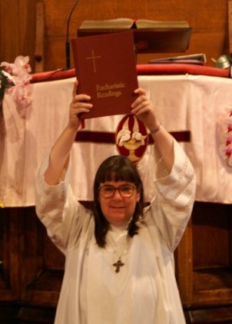
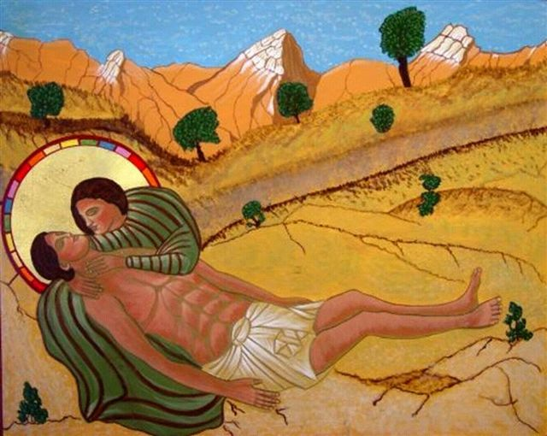
When asked which was the greatest commandment of the Law, Jesus replied, “You must love the Lord you God with all your heart, with all your soul, and with all your mind. This is the greatest and the first commandment. The second resembles it: You must love your neighbor as yourself. On these two commandments hang the whole Law, and the Prophets.”(Matthew 22:37-40). We are called to love God and others as God has loved us. Our belief and experience lead us to affirm that God creates and loves all persons.
There are a few stories of personal love relationships in the Bible. Song of Solomon describes the romantic and erotic love between a man and a woman. The most notable text about love between two men is about David and Jonathan. The bond between them is first mentioned in 1 Samuel 18:1.
When David had finished speaking to Saul, the soul of Jonathan
was bound to the soul of David, and Jonathan loved him as his own
soul…Jonathan stripped himself of the robe he was wearing, and gave
it to David, and his armor, and even his sword and his bow and his belt.
The expensive and personal gifts that Jonathan gave David indicate a deep and intimate relationship. There is no stigma attached to this relationship. Throughout the Bible, David is held up as the greatest of Israel’s monarchs. The text does not say that they were physical lovers, but in David’s time, these are the kinds of gifts that one would bestow on a lover. King Saul, Jonathan’s father, fell from favor with the people as David became more popular. The last time David and Jonathan saw each other, Jonathan warned David that Saul meant to do him harm. Their parting clearly was painful.
David rose from beside the stone heap and prostrated himself with his
face to the ground. He bowed three times, and they kissed each other
and wept with each other; David wept the more. (1 Samuel 20:41)
Upon their deaths in battle against the Philistines, David mourned both Saul and Jonathan. The lament honors Saul as king and grieves Jonathan as a deeply beloved companion in 2 Samuel 1:26.
I am distressed for you, my brother Jonathan; greatly beloved were
you to me. Your love to me was wonderful, passing the love of women.
Heterosexual, Homosexual:
What Does the Bible Say
About Sexuality ?
The Bible is an important source of belief and guidance for many people. Every person of faith reads the Bible through the lenses of belief, tradition, reason, and experience. In studying the Bible, it’s important to consider original language, translation, and how words mean different things at various points in time and in various cultural contexts.
An informed faith considers the insights of history and science and the traditions of worship, doctrine, and service. The Bible teaches about God’s saving love and how it is reflected in God’s relationship to people and peoples’ relationships to one another.
There are very few verses in the Bible that mention sexuality; there are even fewer that refer to what we today would call homosexuality. The word “homosexual” didn’t exist until the 20th century. There are six passages that mention same sex sexual relations .
We are a group of men and women from various religious traditions. Some of us are straight; some are gay; all are Christian. Our goal was a fair and objective look at the six Bible passages that are cited in the discussion and debate about homosexuality. This is what we found .
Biblical Hebrew is a concrete language. It does not and cannot use abstract words Its words are rooted in what can be seen, heard, tasted, smelled, or touched. Biblical Hebrew doesn’t say, “I’m sad”, because ‘sad’ is an abstract idea. Instead, when we read the English word, ‘sad’, the Biblical Hebrew means something more like, ‘downcast’, literally “eyes pointing down”. Think about it: when you’re sad, you often look down, both literally and figuratively.
More detailed information, including denominational and religious positions on homosexuality, can be found at
www.churchofthegoodsamaritan.com

Slide 2
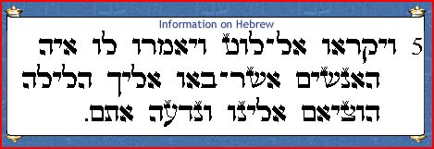

Genesis 19:5
Hebrew Text
King James Version 1611, 1769
  And they called unto Lot, and said unto him, Where [are] the men which came in to thee this night ? Bring them out unto us, that we may know them.
New International Version 1973, 1978, 1984
They called to Lot, “Where are the men who came to you tonight? Bring them out to us so that we can have sex with them.”
Yada, means ‘to know’ and may be understood as to know intimately, eg, sexually. It may also mean ordinary, cognitive knowledge. The visiting men were guests of Lot, and he was obliged to protect them. If the men of Sodom pressed Lot to give his visitors to them sexually, the ‘sin’ would be rape, demonstrating dominance and power over the visitors. This text is not about a consensual act or relationship
The Jerusalem Bible
  Calling out to Lot they said, “Where are the men who came to you tonight? Bring them out to us so that we may abuse them.”
who
Traditionally, the first five books of the Bible were attributed to Moses, who lived around 1350 BC. While some scholars hold to that tradition, many others date this material from after David’s reign to the Restoration, about 950 to 550 BC.
Exclusive Interpretation
Some people have interpreted this scripture as God destroying Sodom because of homosexual acts.
Inclusive Interpretation
what
We believe that the sin of Sodom was inhospitality to strangers and rape, not homosexuality.
Influences
what
This was implied by Jesus
in these verses:
A group of men from Sodom surrounded Lot’s house and demanded that his guests be sent out so they could “know them”. The text leading up to this indicates that Lot’s visitors are “angels”. The Hebrew ‘malak’ can be translated as angel or messenger. Lot offered to give the mob his daughters instead.
where
Matthew
10:14-15
New International Version 1973, 1978, 1984
If anyone will not welcome you or listen to your words, shake the dust off your feet when you leave that home or town. I tell you the truth, it will be more bearable for Sodom and Gomorrah on the day of judgment than for that town.
when
when
Sodom, near the Dead Sea, in what is now Jordan.
why
Probably the early Bronze Age, somewhere between 1800-2300 BC. There was a large earthquake in this area around 2350 BC.
where
Luke
10:10-12
New International Version 1973, 1978, 1984
When you enter a town and are not welcomed, go into its streets and say, ‘Even the dust of your town that sticks to our feet we wipe off against you. Yet be sure of this: The kingdom of God is near’. I tell you, it will be more bearable on that day for Sodom than for that town.
Lot and his family defended their guests, showing hospitality, compassion and respect for them. The “men of Sodom” disregarded the laws regarding such things in favor of their own interests.
Summary
Language is dynamic. It changes intentionally and accidentally through use, misuse, and disuse. Translation increases the possibilities for understanding and misunderstanding words from another language. Translators and readers should try to understand what words meant for their original audience and only after that infer modern ideas, meanings, or applications to what the texts may suggest to later audiences.
The sin or evil of verses 5-9 is failure to observe the laws of hospitality and protection for the visitor. Failure to protect the vulnerable is a sign of Sodom’s general wickedness. The prophets and Jesus cite Sodom for its lack of hospitality and justice. No scripture referring to Sodom specifies a sexual act, though many interpreters today view this text as a threat of rape. Then just as today, rape was a crime, not part of a consensual relationship.

Slide 3

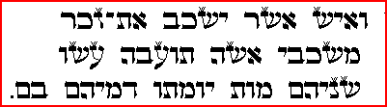
Hebrew Text
Leviticus 18:22
20:13
King James Version 1611, 1769
Thou shalt not lie with mankind, as with womankind: it [is] an abomination. If a man also lie with a mankind as he lieth with a woman both of them have committed an abomination: they shall surely be put to death; their blood [shall be] upon them.
18:22
Shakab, is rendered here as ‘to lie with’. This can mean simply to lie down but can also indicate sexual intercourse.
Zakar, is ‘male’ but is not the usual word for ‘man’ (ish), Zakar is used of humans or animals and implies ‘the one by whom a family line continues’.
New International Version 1973, 1978, 1984
Do not lie with a man as one lies with a woman; that is detestable. If a man lies with a man as one lies with a woman, both of them have done what is detestable. They must be put to death; their blood will be on their own heads.
Tow’ebah, translated ‘abomination’ in the King James Version (1611). This term appears most often in relation to an idol or idolatrous practice, including temple prostitution. It is applied to those things that cause ritual impurity.
The Jerusalem Bible
You must not lie with a man as with a woman. This is a hateful thing. The man who lies with a man in the same way as with a woman: they have done a hateful thing together; they must die. Their blood shall be on their own heads.
what
20:13
who
Often attributed to Moses, c. 1350 BC; many modern scholars view this text as post-exilic, c. 550 BC.
what
Ethical ritual law about unlawful sexual relations.
Exclusive Interpretation
Interpretation
where
God's law says clearly that homosexuality is forbidden and wrong, and persons who do such things should be put to death.
God loves all persons and honors covenantal relationships. Homosexuals are a part of God's creation. Committed homosexual relationships
were unknown or unacknowledged in Judaic
culture.
Post exilic Judea/Israel.
when
Influences
when
About 550 BC.
In Judaism, procreation and family life were essential. The family supported and protected itself, and perpetuating the family was central to survival. Any sexual act that could not result in pregnancy was seen as a waste of potential increase and continuation of the family. This is likely why sex between men, barren women, masturbation, etc., were considered taboos.
This was implied by Jesus in these verses:
why
John
10:9
New International Version 1973, 1978, 1984
I am the gate; whoever enters through me will be saved.
Summary
Matthew
5:11
Matthew
7:1
New International Version 1973, 1978, 1984
Blessed are you when people insult you, persecute you and falsely say all kinds of evil against you because of me.
Do not judge, or you too will be judged.
The Holiness Code (Leviticus 17-27) set down rules to separate Israel from its pagan neighbors. An ‘abomination’ made one ritually unclean. Many things including diet, personal adornment, contact with body fluids, were included in the list of “abominations”. Leviticus 20:9-21 repeats Leviticus 18 and attaches penalties for abominations. Same-sex intercourse is listed along with what we’d call incest as well as intercourse with a woman in menses and sex with a neighbor’s wife.→
The penalty is to be “cut off”: that can mean put to death, but could also mean shunned. One could be restored to ritual purity by washing, fasting, lamenting, sacrificing, or paying a fine for restitution.

Slide 4
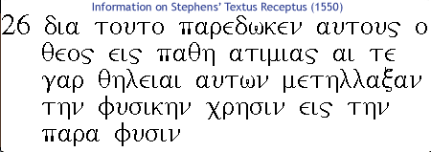
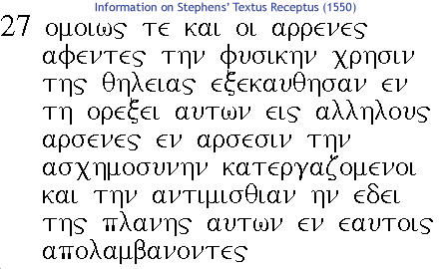
Romans 1:26-27
King James Version 1611, 1769
For this cause God gave them up unto vile affections: for even the women did exchange the natural use into that which is against nature. And likewise also the men, leaving the natural use of the woman, burned in their lust one toward another; men with men working that which is unseemly, and receiving in themselves that recompense of their error which was meet.
Pathos, may be translated as lust or passion. The Greek uses it for both good and bad, happy and sad, welcome and unfortunate events or states of being. The term appears three times in the New Testament, each time referring to something in a negative way.
Atimia, rendered as vile, shameful, and degrading, has its root meaning in being dishonored or disgraced.
New International Version 1973, 1978, 1984
Because of this, God gave them over to shameful lusts. Even their women exchanged natural relations for unnatural ones. In the same way the men also abandoned natural relations with women and were inflamed with lust for one another. Men committed indecent acts with other men, and received in themselves the due penalty for their perversion.
Para, can mean from, to, besides, or near. In English, para-normal means ‘apart from normal’, but para-sail means ‘like a sailing vessel’. Physis, means nature, specifically things not produced/made by human beings. Together, the words “para physis” are rendered in this text as ‘against nature’ or ‘unnatural’
26
Chresis, is the sexual use of a woman. There is no suggestion of emotion.
The Jerusalem Bible
That is why God has abandoned them to degrading passions: why their women have turned from natural intercourse to unnatural practices and why their menfolk have given up natural intercourse to be consumed with passion for each other, men doing shameless things with men and getting an appropriate reward for their perversion.
Greek Text
who
The words. ‘unseemly’, `indecent’, or ‘shameless’ are all used for the Greek term, ‘aschemosune’. Aschemosune, according to Strong is, by implication, the pudenda, or female reproductive organ.
what
The Apostle Paul
where
A letter written to the church in Rome to introduce himself.
Influences
Probably written in or near Corinth as Paul was preparing a trip to Jerusalem, Rome, and Spain.
when
27
when
Most likely written during the height of Paul’s missionary activity, between 50 and 58 A.D.
Plane, rendered by the KJV as ‘error’ is also translated ‘wandering’ or ‘straying’
why
To describe God’s righteousness and explain what happened to those who turned from God to the pagan worship of idols, saying repeatedly, “God gave them up.”
Exclusive Interpretation
Inclusive Interpretation
In the Gospels, Jesus says nothing about what we’d call homosexuality. When he mentions Sodom, it’s in the context of hospitality. The Epistles mention familial relationships and sexual relations.. Abstinence is preferred to all sexual activity.
Saul of Tarsus, a Pharisaic Jew and Roman citizen, was empowered by religious authorities to hunt, arrest, and transport Jews to Jerusalem on charges of blasphemy. He converted to Christianity after a blinding vision on route to Damascus. Thereafter, he is known as Paul. He became a zealous evangelist, establishing congregations and tradition credits him with 13 of the 27 books in the New Testament. These Epistles were written earlier than any of the Gospels.
Any sexual expression between same gendered persons is unnatural.
Paul was writing about idolatrous practices and pederasty, common during this period in Rome, not about loving, committed same gendered relationships.
Summary
Paul, views any sexual activity outside of that designed for procreation as lustful and idolatrous (choice), and unnatural (not producing offspring). Paul uses language associated with pederasty (a young boy used for the sexual pleasure of an older man) and likens it to the way a man might use a woman. He condemns both, and other behaviors, as failures to honor the God of creation by not treating all humans with respect.

Slide 5
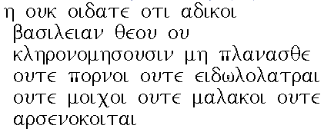
1 Corinthians 6:9
Greek Text
King James Version 1611, 1769
  Know ye not that the unrighteous shall not inherit the kingdom of God? Be not deceived: neither fornicators nor idolaters, nor adulterers, nor effeminate, nor abusers of themselves with mankind
New International Version 1973, 1978, 1984
Do you not know that the wicked will not inherit
the kingdom of God? Do not be deceived: Neither the sexually immoral nor idolaters nor adulterers nor male prostitutes nor homosexual offenders
who
The Jerusalem Bible
You know perfectly well that people who do wrong will not inherit the kingdom of God: people of immoral lives, idolaters, adulterers, catamites
what
where
The Apostle Paul
Aresnokoites means ‘male bed’ and is a term that appears only here and in 1 Timothy. The implication is that of male temple prostitution and with ‘malakos’ may suggest the temple prostitutes are young men forced to work this way.
Malakos means soft or pliable. It is shown in the Bible examples as ‘effeminate’, ‘homosexual’, or ‘catamite’. A catamite is the younger partner in a sexual relationship between a man and a boy.
Paul lists behaviors that he believes are not in keeping with the teachings of Jesus. These include sexual practices that Paul believed distracted from a life committed to God. Paul prefers celibacy to any expression of sexuality, but if a person must be sexually active, Paul urges that the relationship be legitimate and not harmful.
when
Influences
what
Corinth is a Greek city about 50 miles from Athens. It sits on the Isthmus of Corinth, which connects the Peloponnesus to the mainland.
Exclusive Interpretation
when
God's law is clear: homosexuality, along with other types of immoral behavior, are wrong and not part of the will of God
Inclusive Interpretation
why
Written c. AD 54 from Ephesus
Paul is referring to exploitive sexual activity. Human beings should be respectful of others, and not exploit them sexually or treat them as sexual objects. Paul is not talking about homosexual identity or committed relationships, but rather about sexual activity outside of one's normal inclination.
Paul wrote to the Corinthian churches because they were divided in their beliefs and practices, flaunting pride in their righteousness at the expense of humility in their service. Paul’s first letter addresses questions of morality, religious practices, including the remnants of pagan rites, and financial support for the Jerusalem Church.
where
Summary
Biblical Greek, also known as Koine, does employ abstract language, but do not expect to find one-for-one English words conveying the Greek accurately. Biblical Greek has at least four words that are rendered in English as, ‘love’. These words are eros (romantic, physical, or sexual love); philia (friendship); agape (contentment, holding in high regard); storge (natural affection, like that of a parent for a child). No one English word captures the differences, which are clear when we look at the Greek.
Paul addresses sexual activity between a boy, perhaps forced into temple prostitution, and an adult male. Despite its acceptance in Paul’s time, it is not a truly consensual relationship.

Slide 6
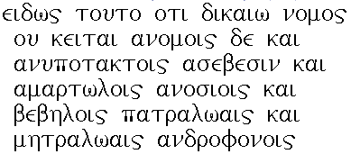
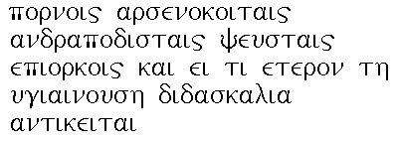
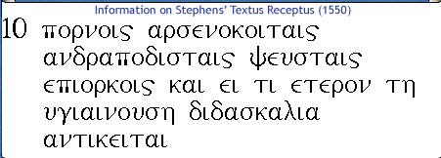
1 Timothy 1:9-10
King James Version 1611, 1769
Knowing this, that the law is not made for a righteous man, but for the lawless and disobedient, for the ungodly and for sinners, for unholy and profane, for murderers of fathers and murderers of mothers, for manslayers, for whoremongers, for them that defile themselves with mankind, for menstealers, for liars, for perjured persons, and if there be any other thing that is contrary to sound doctrine;
Greek Text
9
New International Version 1973, 1978, 1984 We also know that law is made not for the righteous but for lawbreakers and rebels, the ungodly and sinful, the unholy and irreligious; for those who kill their fathers or mothers, for murderers, for adulterers and perverts, for slave traders and liars and perjurers-and for whatever else is contrary to these sound doctrine
‘Arsenokoites’ found only here and in First Corinthians 6:9, refers to men who engage in sexual activity with male prostitutes or slaves.
.
‘Pornos’, translated in the Bible texts as whoremongers or perverts, means a male prostitute.
The Jerusalem Bible
Like any law, in the understanding that laws are not framed for people who are good. On the contrary, they are for criminals and revolutionaries, for the irreligious and the wicked, for the sacrilegious and the irreverent; they are for people who kill their fathers or mothers and for murderers, for those who are immoral with women or with boys or with men, for liars and for perjurers
who
what
10
where
The author of 1 Timothy, probably a follower of Paul, states that the law is good and exists as a guide for just and for disobedient persons.
when
what
Examples are cited for behavior against God's law and will. Concern about heretical teaching in the church.
Exclusive Interpretation
why
Inclusive Interpretation
Influences
The Greco-Roman world.
Homosexuals, along with murderers, liars, and others are not righteous in God's sight.
We believe that after careful study of the original language of the passage does not refer to homosexuality as we know it today but to sexual activity outside of committed relationships. The law was meant to illuminate sinful behavior: murder, adultery, and abuse of others.
1 Timothy was written after the death of Paul, probably by one of his followers.
Establishes informed and appropriate behavior for Christians when male and female prostitution, orgies and dishonest and dishonorable behavior were rampant.
Aramaic is the other language to consider when reading the New Testament. It was dominant in what we call the Middle East from about 700 BCE to 300 CE. Hebrew Bible characters like Daniel and Ezra and New Testament persons like Jesus and his contemporaries would have spoken a form of Aramaic. In a few places in the Greek New Testament, Jesus’ speech is written in Aramaic. An interesting example is found in Mark 15:34 and Matthew 27:46, where Jesus quotes the beginning of Psalm 22: “Eli, eli, lama sabbachthani?” (My God, my God, why have you forsaken me?) The ancient psalm would have been written in Hebrew, but Jesus quotes an Aramaic translation, not the canonical Hebrew Text. For our study, it’s important to remember that the English word, “homosexuality”, did not exist until the early 20th century.
Summary
1 Timothy 1:9-10 lists crimes against persons. Written in the latter part of the first century, the letter is concerned with proper church organization. It warns against specific behaviors common in the Roman world. The first three behaviors in the list are acts of violence. The next four are sex crimes involving kidnapping and forced prostitution. The last three are acts of theft and corruption. The charge is against those who kidnap and sell persons into prostitution and against those making use of sex slaves.

